Slide 1
Data ScieNCE In Healthcare
A WEBINAR By Ankitha Giridhar

Slide 2
Plan of Action
The Lobby - Introducing the Basics
The Backstage – Exploring the Data
The Show – A hands on Experience

Slide 3
The Lobby – An introduction to Data Science

Slide 4
The Definitions
Data science is an inter-disciplinary field that uses scientific methods, processes, algorithms and systems to extract knowledge and insights from many structural and unstructured data.
Artificial intelligence refers to the simulation of human intelligence in machines that are programmed to think like humans and mimic their actions.

Slide 5
Machine learning is an application of AI that provides systems the ability to automatically learn and improve from experience without being explicitly programmed.
Deep learning is an AI function that mimics the workings of the human brain in processing data for use in detecting objects, recognizing speech, translating languages, and making decisions.

Slide 6
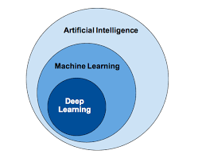
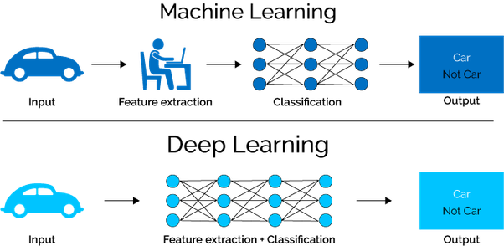
Data Science

Slide 7
AI IN HEALTHCARE
Diagnosis – Using a combination of medical imaging techniques with AI for efficient diagnoses.
Analytics - The medical field is filled with data that needs analysis, e.g. predicting a patient’s reaction to an experimental treatment.
Documentation – Natural Language Processing
Medical Devices – In combination with robotics

Slide 8
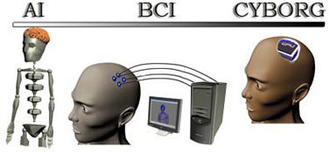
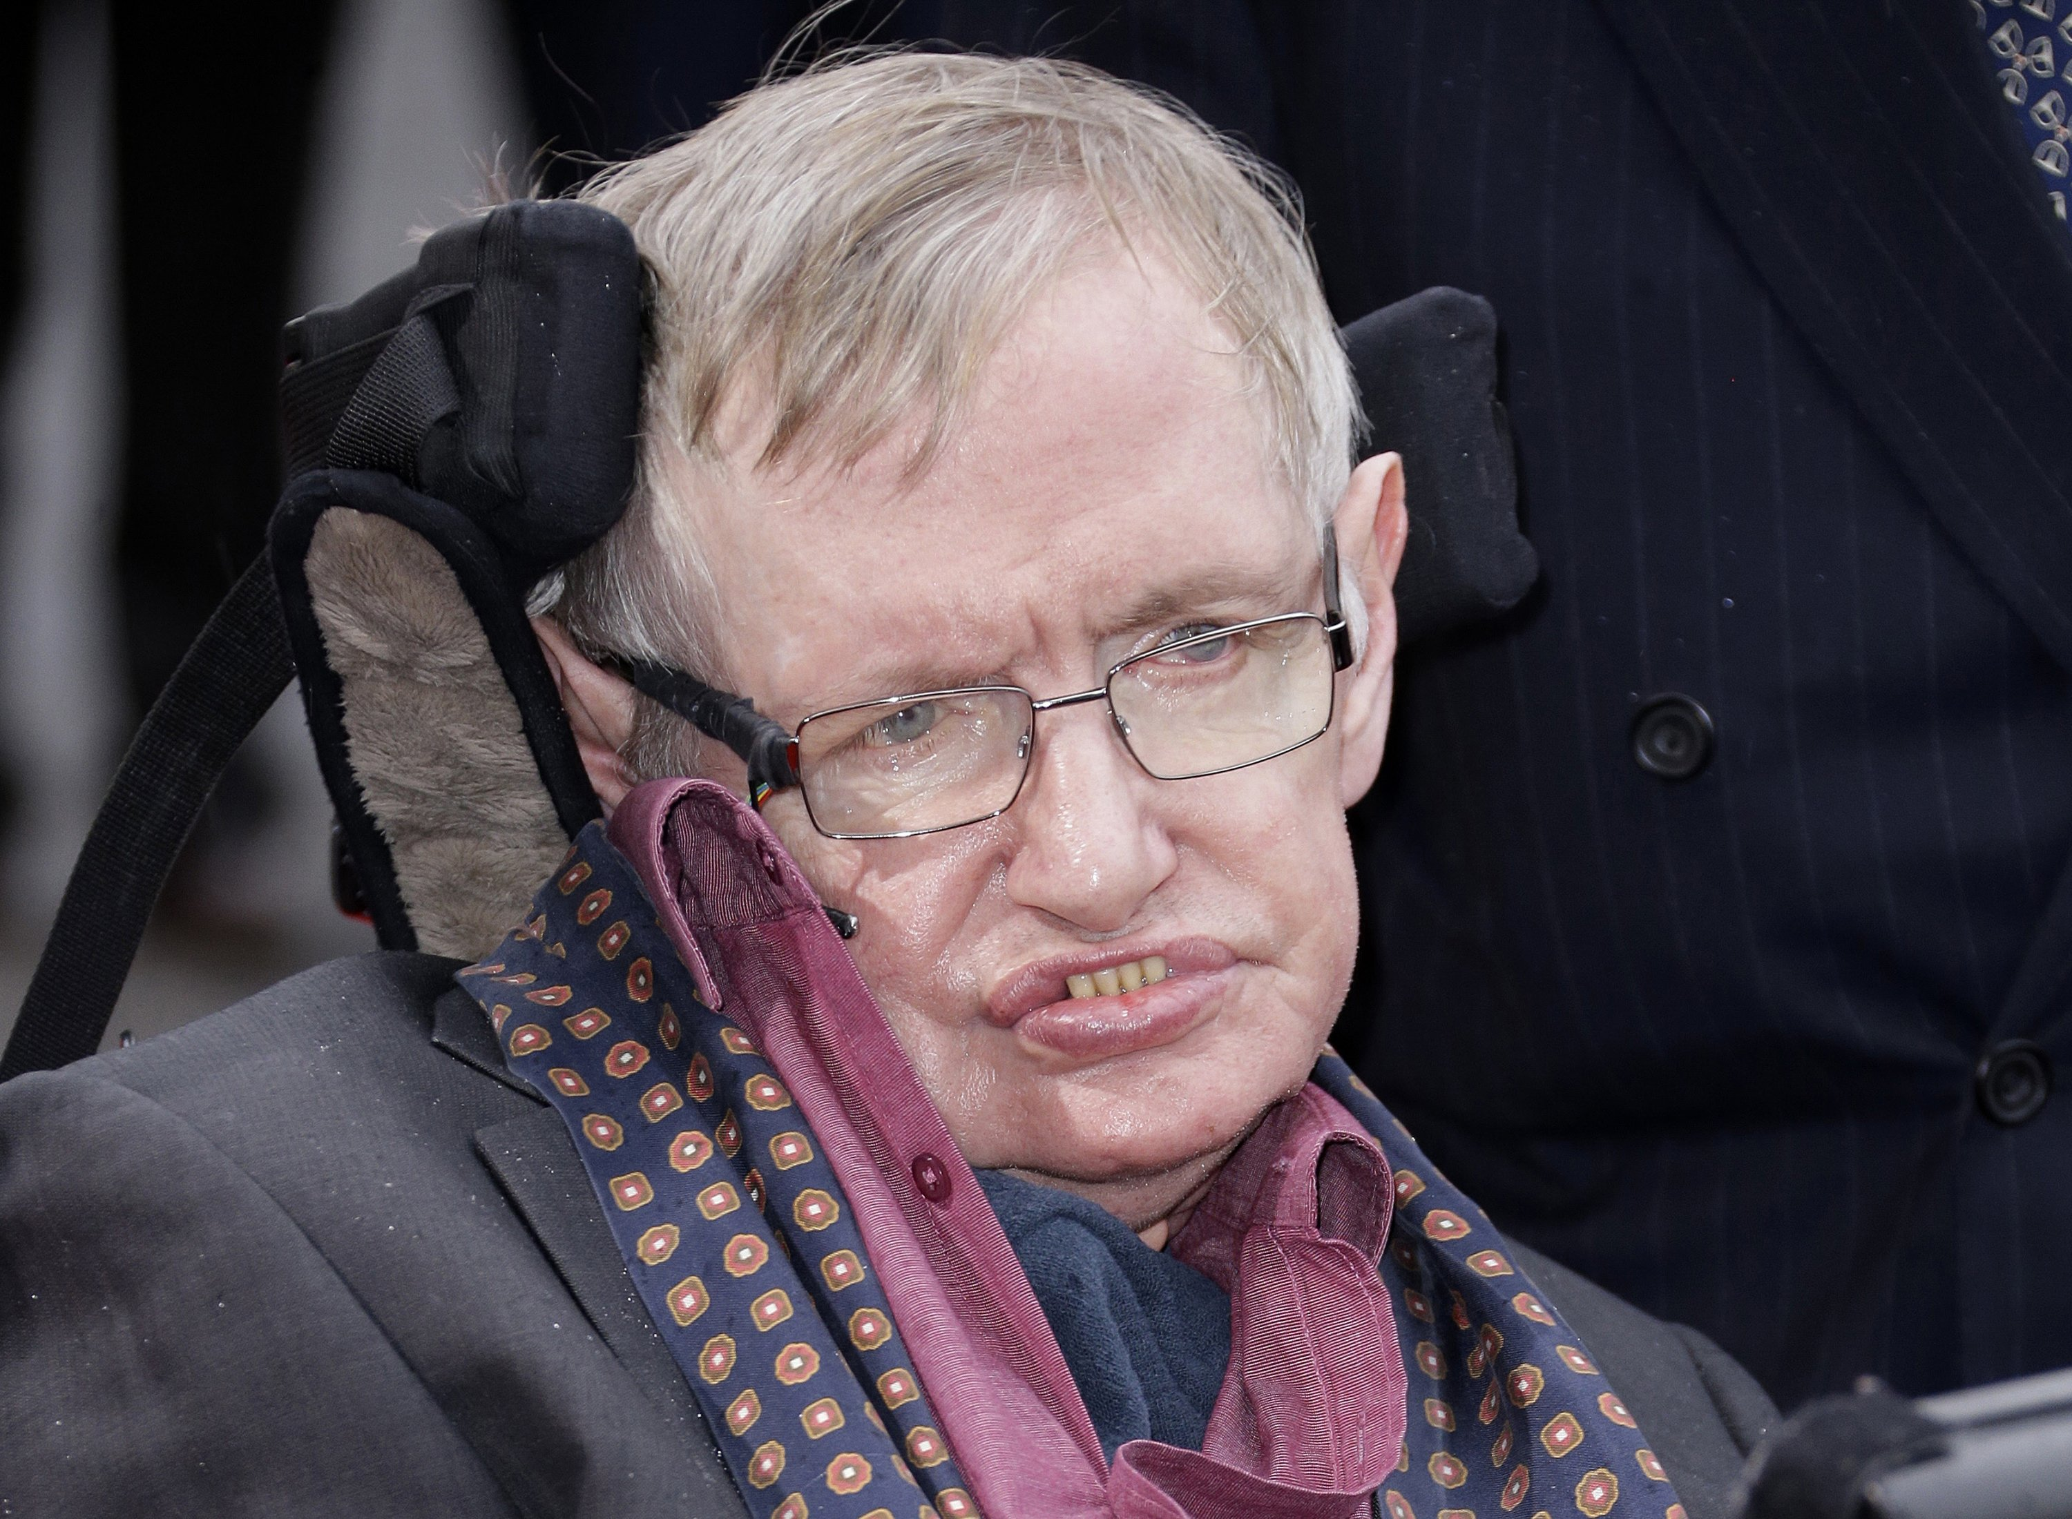
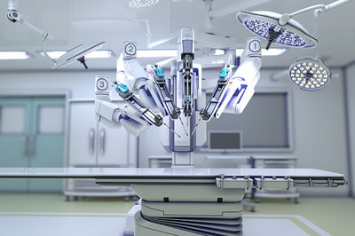
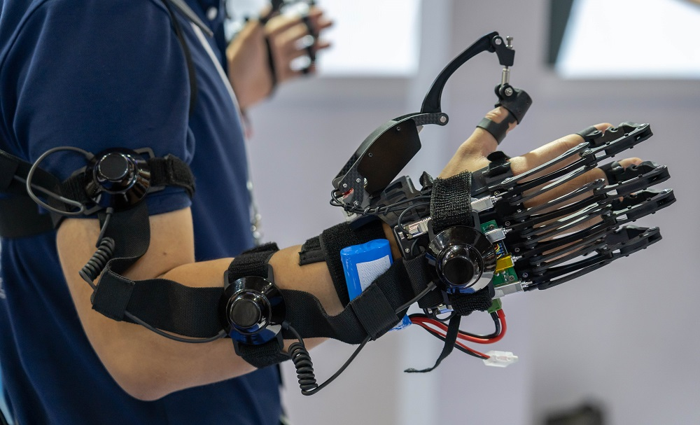
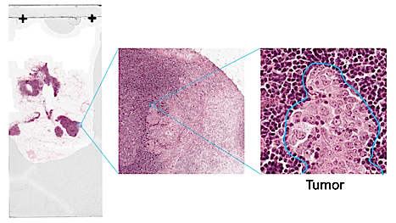

Slide 9
Machine Learning Terminology
Label / Target – The quantity or attribute that is going to be predicted
Feature – An input variable specific to the data given
Example – An instance of the data. It could be labelled or unlabelled, but always has features
Model – Defines the relationship between the labels and the features
Algorithm – A set of instructions, formulae, etc. to define the above relationship

Slide 10
Training Data – Labelled data on which the model is defined
Test Data – Unseen data which the model assigns labels to
Training – The process of using the algorithm to fit the model onto the training data
Testing – Making predictions using the fitted model and evaluating these predictions

Slide 11
Machine learning ALgorithms
Supervised ML – This uses readily available labelled data (historical data) to predict new data.
Unsupervised ML – The data isn’t classified or labelled, and the algorithm uses hidden structures in the data to make predictions.
Reinforcement Learning – This uses a reward feedback system to ‘reinforce’ the algorithm.

Slide 12
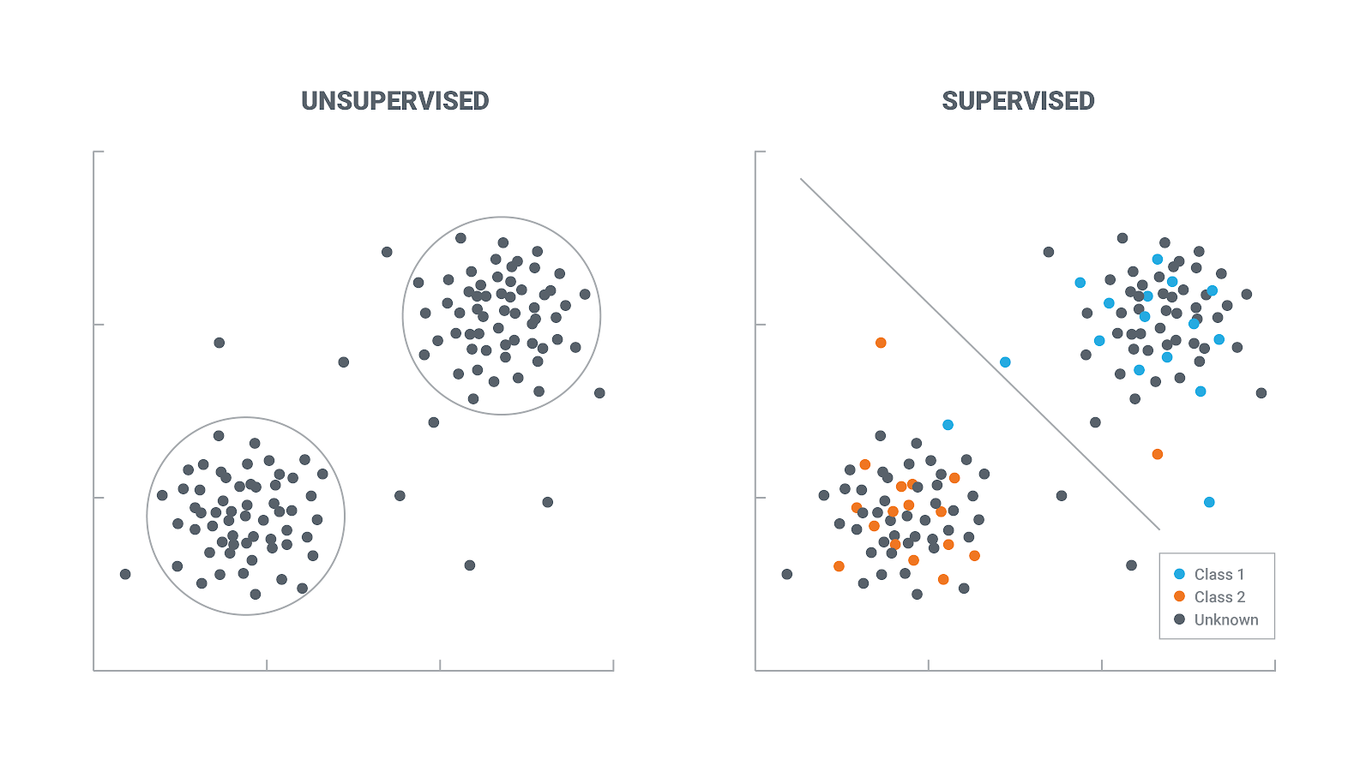
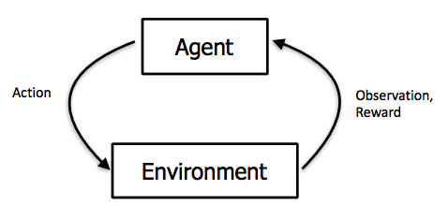
Supervised and Unsupervised ML
Reinforcement Learning

Slide 13
The Venue – A Healthcare Analytics Prediction Problem

Slide 14
Problem Statement
MedCamp organizes health camps in several cities with low work life balance. They reach out to working people and ask them to register for these health camps.
There are three types of health camps. In the first two, the patient is given a health score after a few check -ups. Getting a health score is considered a favourable outcome.
In the third type of health camps, stalls are set up in order to raise awareness. A favourable outcome here would be when a patient visits atleast one stall.
The goal is to predict whether or not the outcome will be favorable.

